Slide 1
Writing Maintainable Code
A Crash Course
Guidelines for making your (future) life easier

Slide 2
About me
Dave Newman
I currently work for Vertiv Corp dba Geist
We build rack Power Distribution Units (rPDUs)
Basically, industrial power strips used in data centers
30+ years creating software, mostly for internal use
I am passionate about software quality
Why – because frankly, most software stinks
…including most of the code I’ve written during my career

Slide 3


Slide 4
Why is maintainability important?
Maintainability has significant business impact
60-80% of software cost is consumed by maintenance activities, whereas writing new code accounts for only about 20% of the total cost
Maintainability is an enabler for other quality characteristics
When your code base is well defined and easily understood, good things happen
Modifications are easier to make
Dependencies and Side effects are minimized
Maintainable code is overall more stable than gnarly, tangled spaghetti code

Slide 5
Software Maintenance
Corrective maintenance (fixing bugs)
Adaptive maintenance (modifying for changes in environment)
Perfective maintenance (meeting changes in requirements)
Preventive maintenance (increasing quality / preventing future bugs)
All these are directly affected by how you write the code in the first place
=> maintainability

Slide 6
Writing maintainable code is (not) hard!
Follow simple guidelines
Simple guidelines are easier to follow than complicated rules or rituals
Simple rules are easier to remember
Simple logic is easier to debug

Slide 7
Writing maintainable code is (not) hard!
Write maintainable code from the start
Maintainability is not an afterthought
Every contribution counts
More experienced developers should set the bar for less experienced developers

Slide 8
Debugging code is twice as hard as writing the code in the first place. Therefore, if you write the code as cleverly as possible you are, by definition, not smart enough to debug it.
Brian Kernighan, co-Creator of the c language
Some speakers and authors use the violent psychopath scenario, whereby you should write the code as if the next person to debug it will be a violent psychopath – who knows where you live…
…and it might be you.

Slide 9
What makes software maintainable? simple guidelines that are easy to remember and practice
Write short units of code
Write simple units of code
Write code once
Separate concerns in modules
Couple architecture components loosely
Keep architecture components balanced
Keep your codebase small
Automate tests
Write clean code

Slide 10
Software Improvement Group (SIG)
The first 8 guidelines are measurable code quality metrics derived from the SIG/TUViT1 Evaluation Criteria for Trusted Product Maintainability
The remaining 2 are process guidelines (regarding clean code and automation) considered to be the most critical and under the software developer’s direct control
SIG is a software management consulting company that has been measuring software quality and advising about it since 2000
As of 2015, SIG has analyzed 7.1 billion lines of code, and 72.7 million new lines of code are uploaded to SIG weekly

Slide 11
Write Short Units of Code
Limit the length of code units (methods/functions) to 15 lines of code
Every line that is not empty and does not contain only a comment counts as a line of code
Some authors start at the line containing the first opening brace
Personally, I use separate lines for the opening and closing braces. To me, this hardly counts as a line of code – so I willfully violate this guideline all the time
This also applies to function calls – you can count the opening and closing braces or not

Slide 12
Minimum thresholds for a 4-star unit size rating (2015 version of the SIG/TUViT Evaluation Criteria)
Lines of code in methods with …
Percentage allowed for 4 stars for unit size
… more than 60 lines of code
… more than 30 lines of code
… more than 15 lines of code
… at most 15 lines of code
At most 6.9%
At most 22.3%
At most 43.7%
At least 56.3%

Slide 13
Why so short?
Short units are easy to test
Short units are easy to analyze and understand
Short units are easy(er) to reuse

Slide 14
Write Simple Units of Code (Manage Complexity)
To manage complexity, you have to be able to measure it
There are four key software structural complexity metrics:
Cyclomatic complexity
Depth of decision nesting
Number of parameters / size of interface
Fan out

Slide 15
Write Simple Units of Code (Cyclomatic Complexity)
Cyclomatic Complexity is the number of branch points plus 1
Every decision point is a branch point
if, elseif (else doesn’t count)
select/switch (1 for each case, but there are exceptions)
for
do
while
catch
? (ternary)
Null conditional (?.) and null coalescing (??) operators (C# 6)

Slide 16
Write Simple Units of Code (Cyclomatic Complexity)
Limit the number of branch points per unit to 4
Do this by splitting complex units into simpler ones (refactor!)
This improves maintainability because it makes units easier to modify and test

Slide 17
Write Simple Units of Code (Cyclomatic Complexity)
1-4 – great
5-9 – ok
10-14 – warning (justified?)
15+ - really bad (fix it)

Slide 18
Write Simple Units of Code (Depth of decision nesting)
Determined by counting curly braces, indents, etc.
No more than 4 is best
Related to size of the code unit
Mitigate this by inverting logic or using helper methods

Slide 19
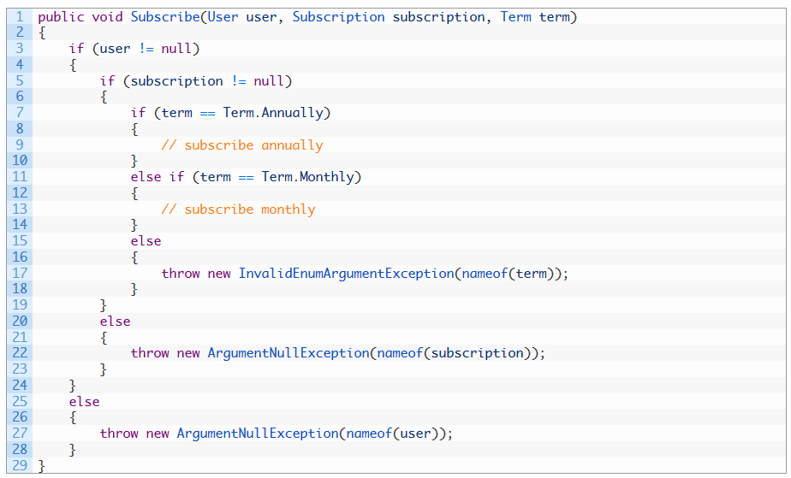
Write Simple Units of Code Eliminate unnecessary nesting by…

Slide 20
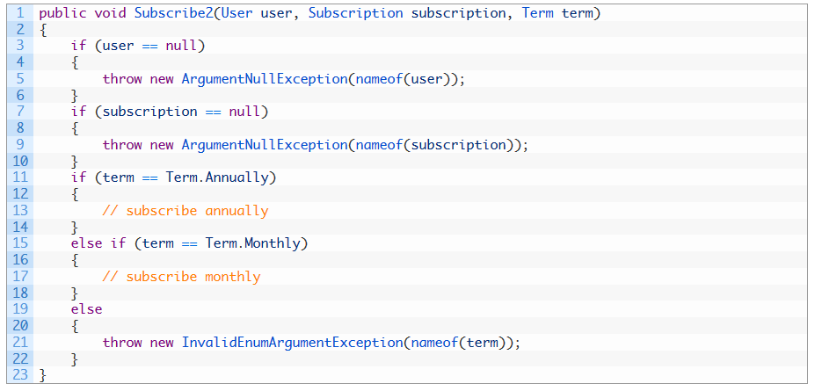
Write Simple Units of Code inverting logic to reduce nesting – or…

Slide 21
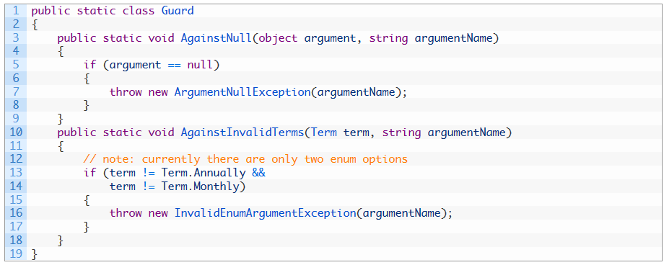
Write Simple Units of Code using helper methods.

Slide 22
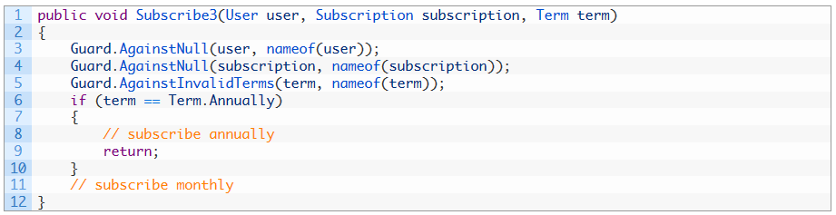
Write Simple Units of Code Original method using Guard clauses – no nesting!

Slide 23
Write Simple Units of Code (Depth of decision nesting)
1-4 – green
5-6 – yellow (justified?)
7+ - red (fix it)

Slide 24
Write Simple Units of Code (Limit number of Parameters)
Limit the number of parameters per unit to at most 4
Do this by extracting parameters into objects
This improves maintainability because keeping the number of parameters low makes units easier to understand and reuse
Large interfaces are usually not the main problem; rather, they are a code smell that indicates a deeper maintainability problem

Slide 25
Minimum thresholds for a 4-star unit size rating (2015 version of the SIG/ TUViT Evaluation Criteria)
Lines of code in methods with …
Percentage allowed for 4 stars for unit interfacing
… more than seven parameters
… five or more parameters
… three or more parameters
… at most two parameters
At most 0.7%
At most 2.7%
At most 13.8%
At least 86.2%

Slide 26
Write Simple Units of Code (Limit number of Parameters)
1-4 – green
5-6 – yellow (justified?)
7+ - red (fix it)

Slide 27
Write Simple Units of Code (Fan out)
Fan out is a measure of how many methods are called per unit
Often due to “Necessary complexity”
Necessary complexity is inherent in the problem space
Refactoring helps manage this type of complexity
Design patterns can also be a huge help!
.

Slide 28
Write Simple Units of Code (Fan out)
1-6 – green
7-9 – yellow (justified?)
10+ - red (fix it)

Slide 29
Write Code Once
This is the Don’t Repeat Yourself (DRY) principle restated
According to SIG, a duplicate or code clone is an identical piece of code at least six lines long, excluding whitespace and comments
Use refactoring techniques such as Extract Superclass to help identify and eliminate duplicated code
Violating this is especially egregious when entire modules are duplicated (a good segue to the next category)…

Slide 30
Write Code Once
HOWEVER…
Introducing too many parameters or variables, or jumping through some other set of hoops…
…in an attempt to reuse code…
…just so you can say you followed the DRY principle…
…is missing the point.

Slide 31
Writing Maintainable Code
Previous topics are concerned with unit guidelines (methods and constructors)
The next 5 topics are concerned with module level guidelines
A module is called a class in C# and other OOP languages
Many of these principles align with the SOLID principles of OO design, but the focus is on maintainability
Generalities that can be applied to any design paradigm

Slide 32
Separate Concerns in Modules
Avoid large modules
Assign responsibilities to separate modules
Hide implementation details behind interfaces (design by contract)
Abstraction gives you permission to ignore the implementation details
Encapsulation hides those details
Design by contract enforces encapsulation

Slide 33
Generic Architecture for Software Change
Independent, Clean, Evolutionary Architecture
Contracts
Hosts
Models
Managers
Engines
Services
Tests
Models
Contracts
Models
Engines
Services
Hosts
Managers
Managers
Contracts
Engines
Services
Hosts
Tests
Tests
Dependency
Communication
Notes:
Author / presenter Ken Hill (flipthetrain), 2019 Nebraska.Code()

Slide 34
Couple Architecture Components Loosely
Coupling means that two parts of a system are somehow connected when changes are needed
Coupling may be direct calls, but classes could also be connected via a configuration file, database structure, or even assumptions they make (in terms of business logic)

Slide 35
Couple Architecture Components Loosely
Minimize the amount of code (or logic) within modules that is exposed to access by modules in other components
Independent components enable isolated maintenance
Fewer dependencies makes for simpler tests and better test coverage
Internal calls are OK
Outgoing calls are also OK as they delegate concerns to other components
Note – these calls are incoming calls to other components…

Slide 36
Keep Architecture Components Balanced
Balance the number and relative size of top-level components
Do this by organizing code in such a way that the number of components is between 6 and 12 (close to 9) and are of approximately equal size
This helps in locating code and allows for isolated maintenance
Yikes!
Before you run for the door…
…this is an indicator of good design, not a goal in itself

Slide 37
Keep Your Codebase Small
Keep your codebase as small as feasible
Avoid codebase growth, actively reduce system size
This improves maintainability because having a small product, project, and team is a success factor
Thanks, SIG…

Slide 38
Keep Your Codebase Small
Do not copy and paste code
Refactor existing code
Use third-party libraries and frameworks
Split up a large system
Move the complexity up to DevOps ☺

Slide 39
Automate Tests
Automate tests for your codebase by writing automated tests using a test framework
This improves maintainability because automated testing makes development predictable and less risky

Slide 40
Automate Tests
Automated testing makes testing repeatable
Automated testing makes development efficient
Automated testing makes code predictable
Tests document the code that is tested
Writing tests makes you write better code

Slide 41
Automate Build and Deployment
OK, this one is mine – it should have been included but wasn’t
Automated build and deployment is stable, predictable and repeatable
The time spent maintaining build and deployment scripts is trivial compared to the time spent chasing vagaries in compute environments

Slide 42
Write Clean Code Writing clean code is what you must do in order to call yourself a professional. —Robert C. Martin
Clean code is maintainable code
In this context, writing clean code means not leaving code smells behind after development work
Apply the Boy Scout rule to your software development work
Leave the code (campground) cleaner than you found it

Slide 43
SIG’s Seven developer “Boy Scout rules”
Leave no unit-level code smells behind
Leave no bad comments behind
Leave no code in comments behind
Leave no dead code behind
Leave no long identifier names behind
Leave no magic constants behind
Leave no badly handled exceptions behind

Slide 44
Leave no unit-level code smells behind
Three guidelines deal with smells at the unit level -- long units, complex units, and units with large interfaces
For modern programming languages, there is really no good reason why any of these guidelines should be violated when you are writing new code
To follow this rule is to refactor “smelly” code as soon as possible but certainly before the code is committed to the version control system

Slide 45
Leave no bad comments behind
Comments should explain why, not what or how
No end-of-line comments!
Comments are valuable in only a small number of cases
Always avoid dogmatic boilerplate comments

Slide 46
Leave no code in comments behind
See previous rule
You can always get to deleted code in your source repository

Slide 47
Leave no dead code behind
Dead code comes in 2 flavors
Code that executes but the output or result is never used
Code that is never executed

Slide 48
Leave no long identifier names behind
Identifier names that are too short are just as bad
Omit words that are obvious given a variable’s or parameter’s type
Omit any additional extraneous words that don’t disambiguate the name
When in doubt, leave it out
Avoid words that really don’t mean much of anything
Server, Manager, Value, Object…

Slide 49
Leave no long identifier names behind
Don’t use words you know from the surrounding context
A method or field occurs in the context of a class. A variable occurs in the context of a method. Take that context for granted and don’t repeat it
This means that the more deeply nested a name is, the more surrounding context it has
That in turn means it usually has a shorter name
The effect is that identifiers with more restricted (shorter) scopes have shorter names
MacAddress.GetNext() is better than MacAddress.GetNextMacAddress()

Slide 50
Leave no magic constants behind
NO absolute values
Avoid string constants

Slide 51
Leave no badly handled exceptions behind
Never catch an exception and eat it without a comment as to why you are doing so
Good use of a comment?
Throw where the exception occurs
Let exceptions bubble up to the highest possible level in your code
Catch where execution cannot continue without handling the exception

Slide 52
Credits and Sources
Building Maintainable Software
Ten Guidelines for Future-Proof Code
Joost Visser, et al, Software Improvement Group (SIG) – 2015 Oreilly
Guard Clauses
https://github.com/ardalis/GuardClauses
Software Design online course
Steve Tockey, Construx
Generic Architecture for Software Change
Ken Hill, Nebraska.Code() 2019

Slide 53
Thank you - write better code!
@DaveN59
DaveN3092@gmail.com
https://github.com/DaveN59/Writing-Maintainable-Code

